Slide 1
Unlimited—How Can I Have Unwavering Faith for My Future?
Ch. 10

Slide 2
Looking back . . .
Looking back, review with each other the four encounters that the authors have described that took place between Jesus and Thomas.
(p. 173)

Slide 3
2. From reading I Corinthians 15, verses 3-8, how many people are said to have seen Jesus at one time after the resurrection? (p. 174)

Slide 4
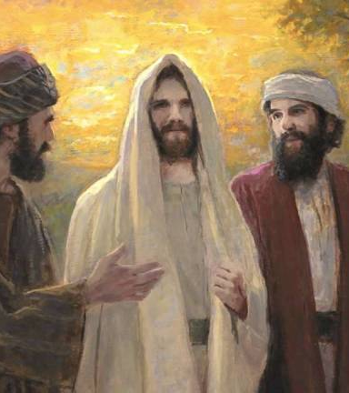
Insights ...
3. From reading Acts 1, verses 4-8, what were Jesus’ last instructions to Thomas and the other apostles just before He ascended into Heaven? (p. 175)
This Photo by Unknown Author is licensed under CC BY-NC

Slide 5
4. From Hebrews 7, verse 25, and from Hebrews 9, verse 24, where is Jesus now and what is He doing? (p. 176)

Slide 6
LEGACY
5. Thomas received the fullness of the Holy Spirit as described in Acts 2, along with the others in the Upper Room. In light of the evidence that Thomas was killed while preaching Jesus Christ in India, how would you describe the difference the fullness of the Holy Spirit made in his life? We have learned that some people in India can trace the salvation of their ancestors to the ministry of Thomas. (p. 177)

Slide 7
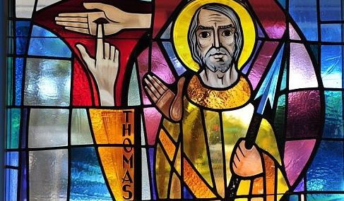
6. From Revelation 21, verses 10 and 14, what location is described as the place where Thomas’ name will be displayed for all eternity?
This Photo by Unknown Author is licensed under CC BY-NC-ND

Slide 8
All IN
7. In summary, when you receive your own God-assignments, when you go through persecutions, instead of choosing silence and safety, you must be committed to stand-up for Jesus and be
“Brave Enough to Believe.”

