Slide 1
Brave Enough to Believe
Called Out of the Crowd – How Can I Be Certain I Am Hearing from God? Ch. 2

Slide 2
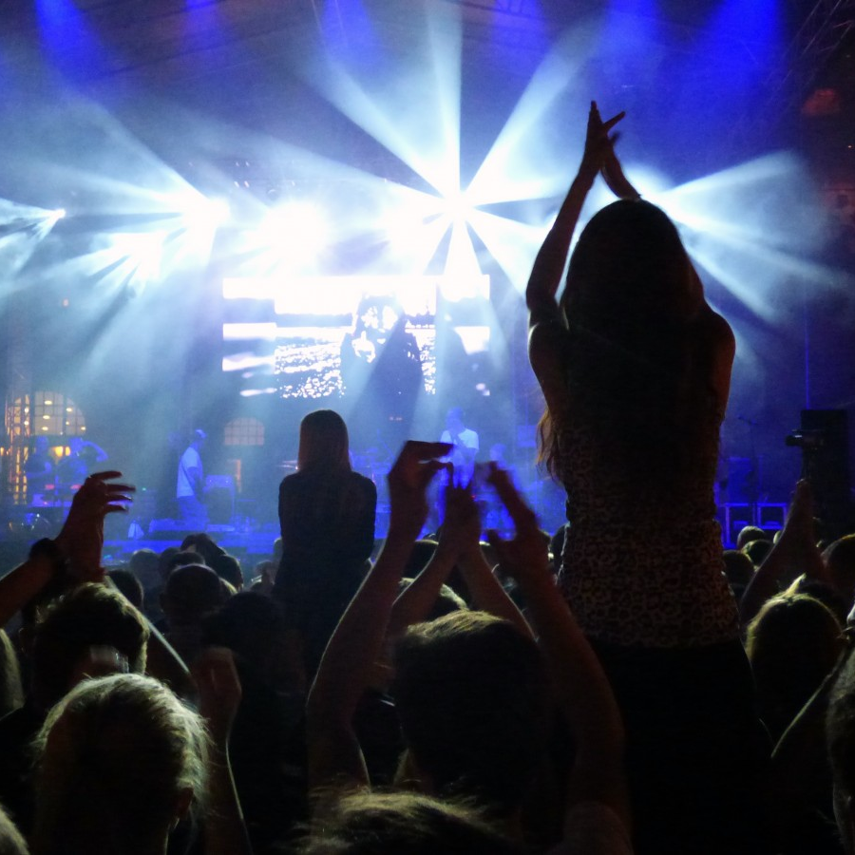
ScripturE . . . Luke 6:12-16
Could you put into words for us the way you have seen the Lord call you out of a crowd to fill the place you are filling, whether for your marriage, your job or your church family?
(p. 19-20)

Slide 3
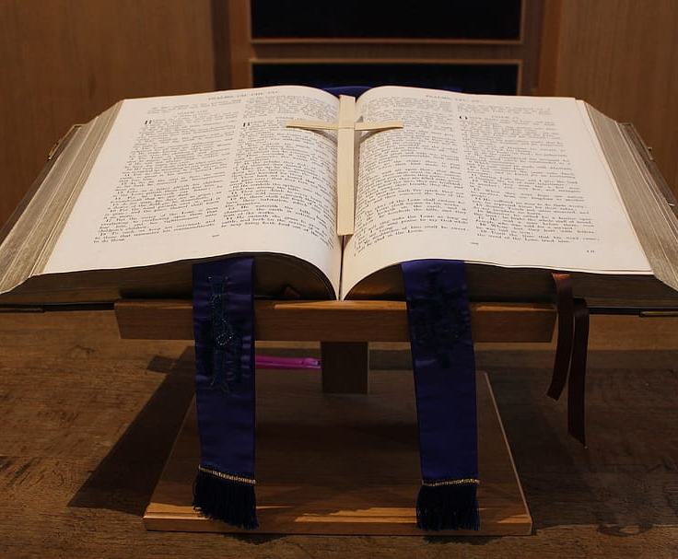
Insights . . .
2. Have you had an experience of believing you heard the voice of God and it was later confirmed that it was the Lord? (p. 22)

Slide 4
Answered Prayer
3. Tell us when you received confirmation of an answer to prayer by seeing circumstances align in a way that only God could have made it possible.

Slide 5
Cultural Impact . . .
4. Having had a close relationship with Jesus, tell us where you believe you had an
impact on the culture around you, such as on the job. (p. 23)

Slide 6
Obedience
5. Was there a time when you felt that you failed to obey the Lord and you struggled to know the difference
between the hope-filled conviction of the Holy Spirit
and the condemnation from Satan that leads to hopelessness? (p. 24)

Slide 7
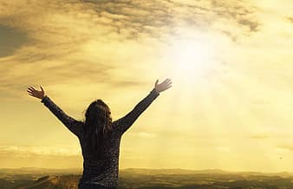
Prayer

