Slide 1
Brave Enough to Believe Ch. 4
A Setup – How Can I Get Untangled from Uncertainty and Overcome My Fear of the Unknown?

Slide 2
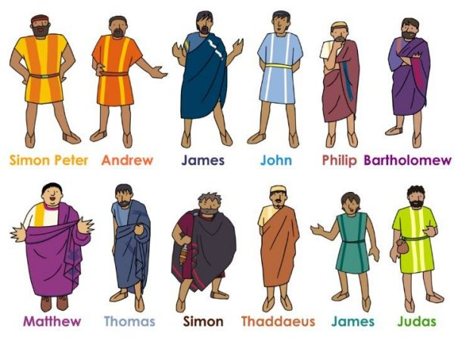
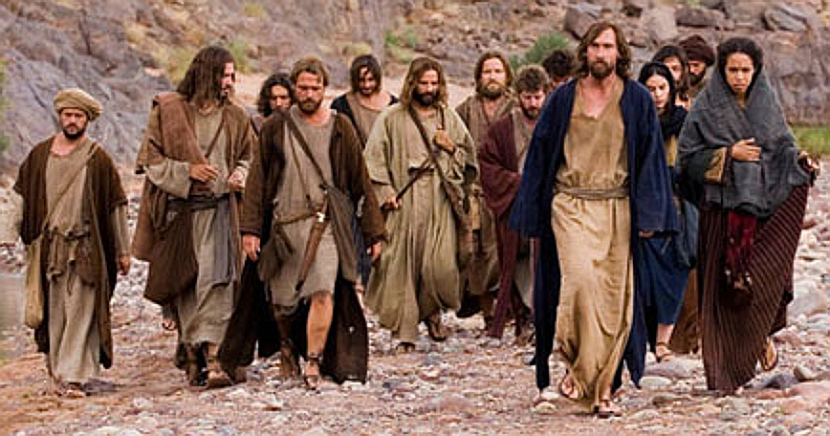
Jesus and the Twelve Disciples
Historical Review in the Book of John
This Photo by Unknown Author is licensed under CC BY-SA
This Photo by Unknown Author is licensed under CC BY-NC-ND

Slide 3
John 11 -- Lazarus
John 11:1-4 What happened to Lazarus?
What is the meaning of the phrase,
“the glory of God.” (p. 57)
Exodus 15:11
Revelation 4:11

Slide 4
John 11: 1-3 Lazarus

Slide 5
Mary & Martha

Slide 6
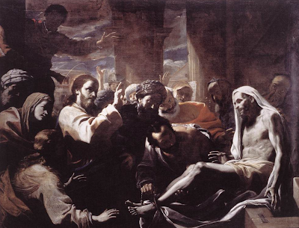
“God’s Timing”
Our questions about God’s timing are opportunities for God’s glory.
John 11: 5-6
Philippians 4: 6-8
This Photo by Unknown Author is licensed under CC BY-NC-ND

Slide 7
Philippians 4: 6-8
Do not be anxious about anything, but in everything by prayer and supplication with thanksgiving let your requests be made known to God. And the peace of God, which surpasses all understanding, will guard your hearts and minds in Christ Jesus.
Devotional
https://www.bible.com/bible/59/PHP.4.6-8.ESV
https://www.bible.com/verse-of-the-day/PHP.4.6+PHP.4.7+PHP.4.8/62594?version=59

Slide 8
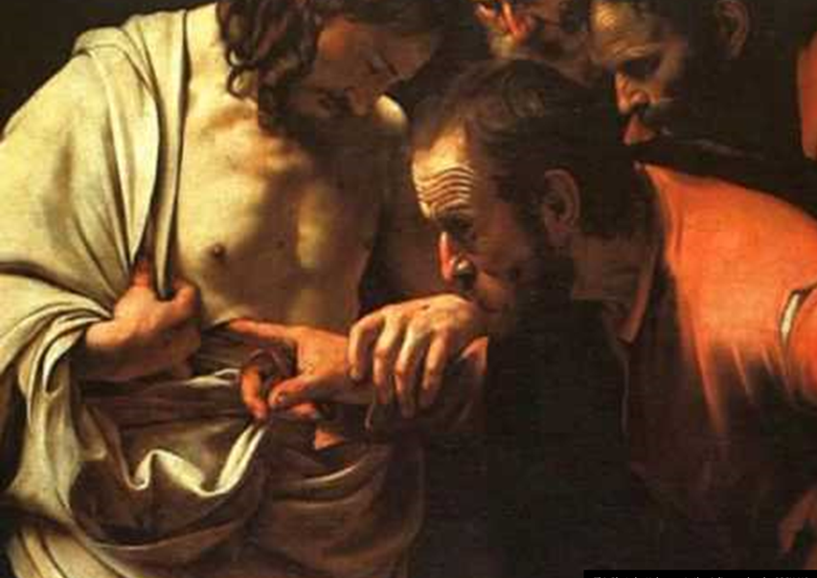
God’s Direction
John 11: 7-8
A “Setup” for Thomas to reveal his bravery and loyalty to Jesus

Slide 9
Lazarus John 11:11-15

Slide 10
Insights . . .
Tell us of an experience where you could tell that God wanted you to do something different or move to a different location, but you gave Him excuses for not doing it?
How did it turn out?

Slide 11
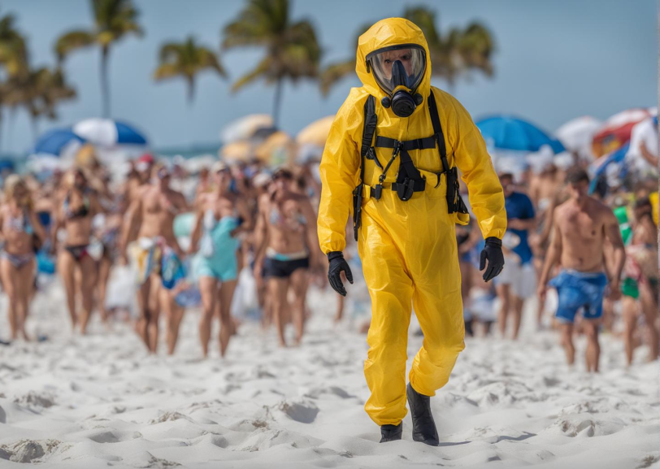
News Headlines
War
Floods
Disease
Faith Over Fear!
Florida on Alert: Leprosy Cases Surge, Risk of Endemic Outbreak Looms
https://www.nbcnews.com/health/health-news/leprosy-may-be-endemic-florida-cdc-rcna97567

Slide 12
“But God . . .”
When we seek self-preservation instead of full surrender, we stifle our spiritual growth and minimize our impact for the kingdom of God.

Slide 13
Personal Prayer
Jesus, help me to trust Your timing, even when I don’t understand.
More than anything, I want to see Your glory through my life and decisions.

