Slide 1
Brave Enough to Believe
Ch. 5
A Set-Up - How Do I Leverage Adversity to Make Me Stronger and Lead with Confidence?

Slide 2
Review

Slide 3
Thomas Stepped Up
Read John 11:16
How did Thomas step up for Jesus?
To whom was Thomas speaking? (p. 73)
This Photo by Unknown Author is licensed under CC BY-NC-ND

Slide 4
When Thomas stepped up, how would you describe the effect it had on the other apostles?
This Photo by Unknown Author is licensed under CC BY-SA

Slide 5
Personal Experience
Have you had an experience in which you stepped up for Jesus?
What effect did it have on someone?

Slide 6
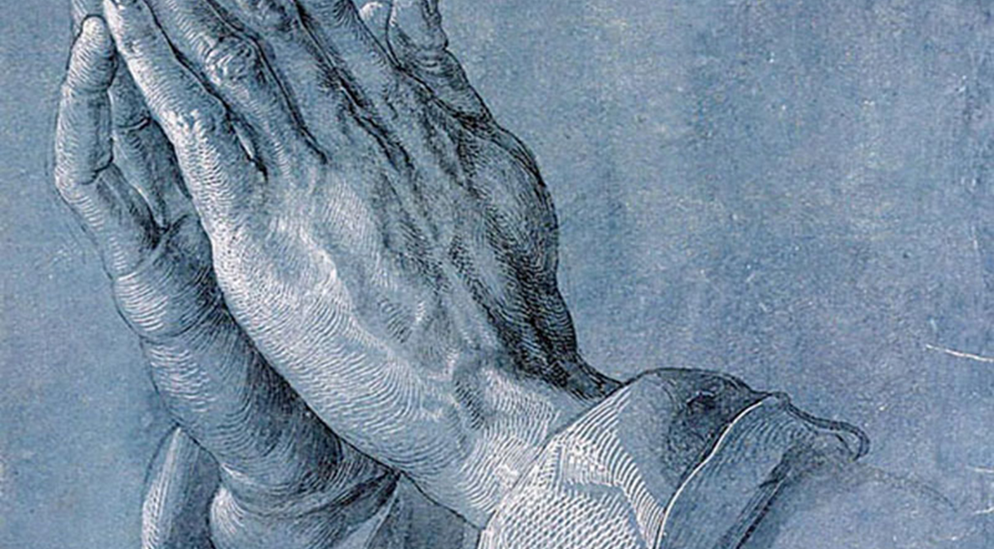
If you are questioning the wisdom of stepping up (or speaking out) for Jesus in a situation, how can it help you to “stop, look, and listen.”
(p. 77)

Slide 7
If a person might risk death to follow Jesus, what does it mean to say they could have a slow death by being complacent and doing nothing? (p.84)

Slide 8
Mountain Top Experiences
Climbing Mt. Kilimanjaro
Seeing the Milky Way
Standing up for Jesus . . .

Slide 9
Jesus called for Lazarus to come out of the tomb.
When he stepped out, what do you think he might have said or done?
What reaction do you believe he might have exhibited? (p. 84)

Slide 10
Insights from the Perspective of Mary & Martha
Devotional
This Photo by Unknown Author is licensed under CC BY-NC-ND

Slide 11
How has this story affected your view of Thomas?
His actions were framed by desire, decision, and determination.
This Photo by Unknown Author is licensed under CC BY-SA

Slide 12
Pray for Wisdom
James 1:5 ESV
If any of you lacks wisdom, let him ask God, who gives generously to all without reproach, and it will be given him.
Personal Prayer:
God, give me the courage to speak up when my voice is needed. I surrender my desires to You.

