Slide 1
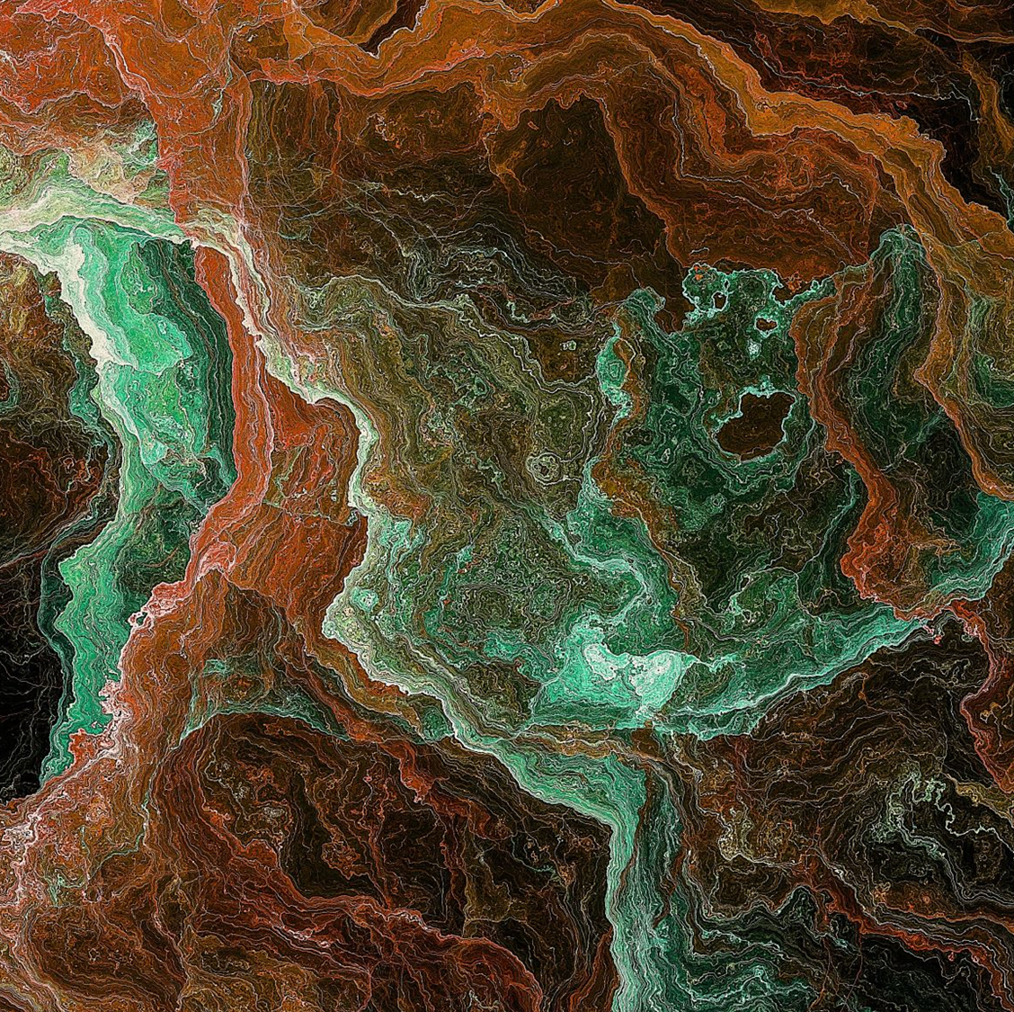
The Place – Who and What is in Heaven?
Ch 6

Slide 2
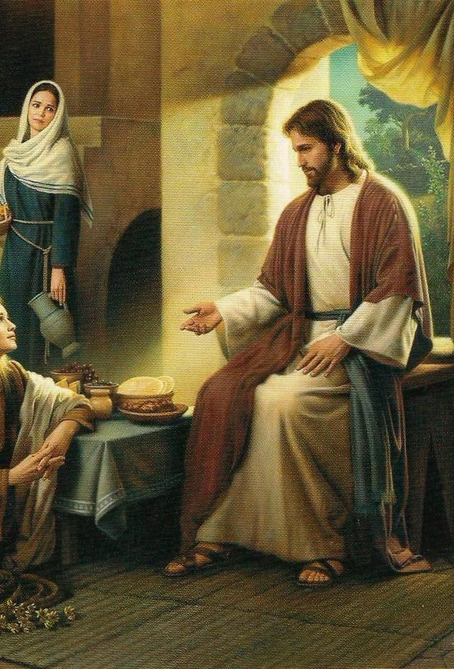
Scripture John 14:1-4
1. Mary honored Jesus by pouring expensive perfume on His feet to honor Him.
Someone thought it was a waste. Have you had an occasion when you were criticized for making a sacrifice for the Lord, whether for your financial gift or giving of your time or fasting and praying? (p. 98)
This Photo by Unknown Author is licensed under CC BY-NC-ND

Slide 3
During the week prior to the crucifixion of Jesus, He sought to prepare the apostles to live without Him in His visible form and to look forward to being together in the future.
Jesus said to them, “You know where I am going, and you know the way.”
Thomas was the only one bold enough to tell Jesus, “No, we don’t know where you are going, and we don’t know the way to get there.”
What are some ways Jesus could have reacted to Thomas and what is the way He answered Thomas?
(p. 101)

Slide 4
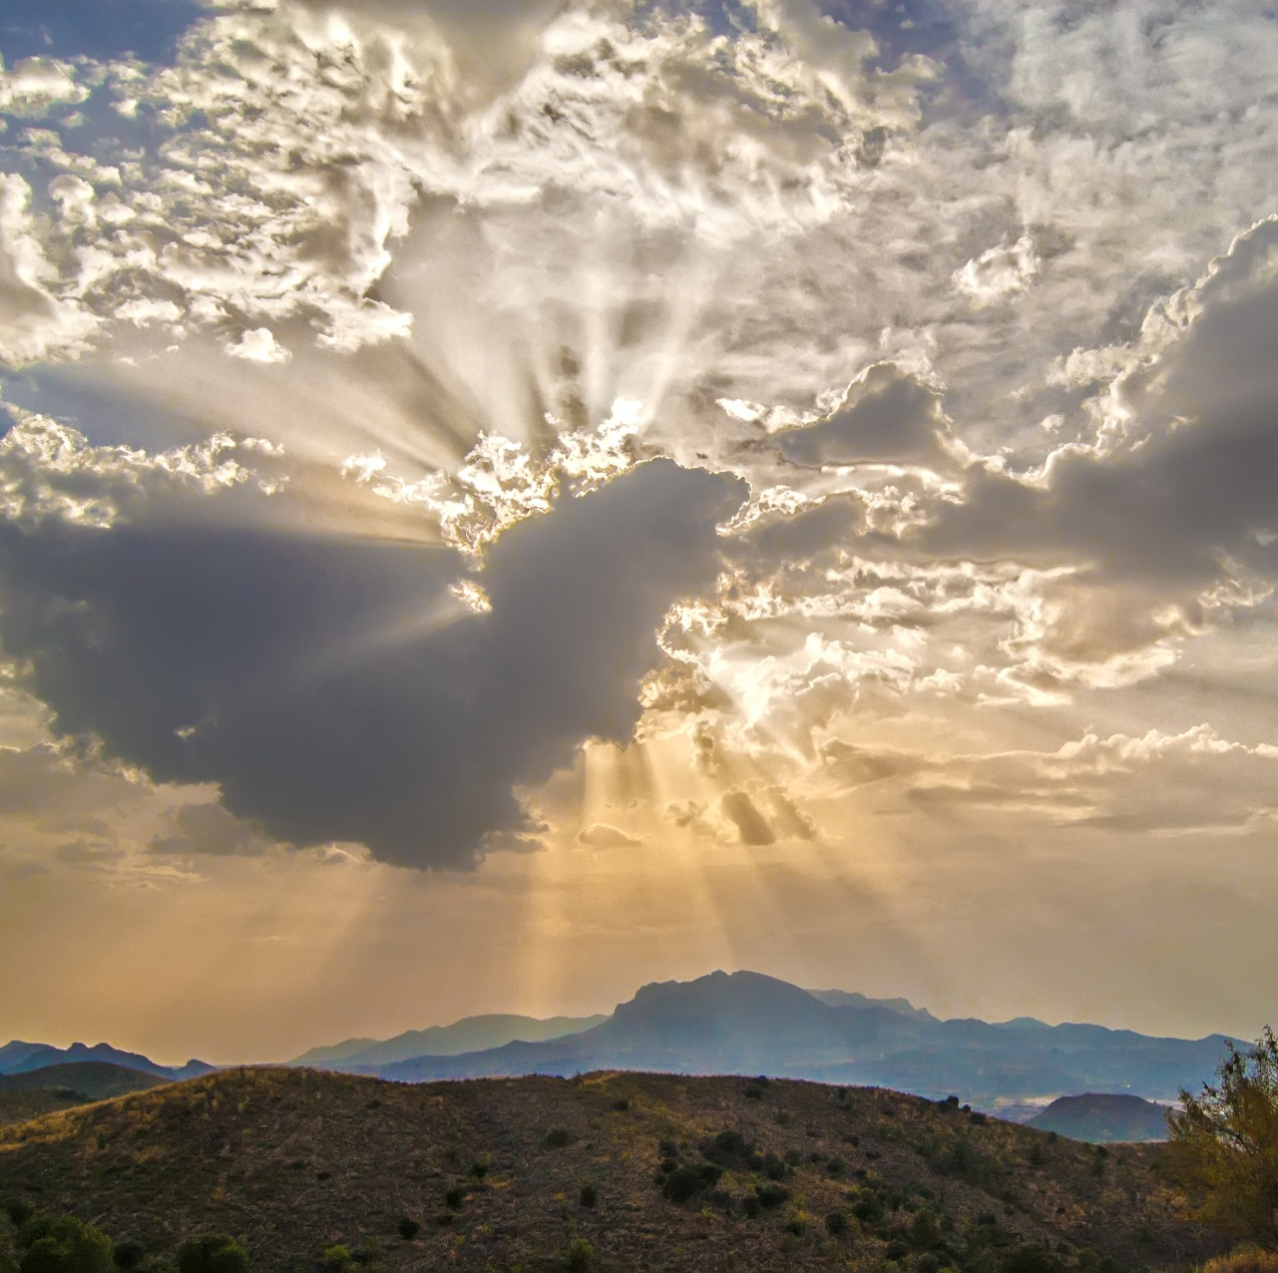
Heaven
3. What are words we sometimes use to describe “Father’s House?” (p. 103)
4. Who is in Heaven? (p. 104-105)
5. Who is not in Heaven? (p. 106)
6. What does Heaven look like? (p. 107-108)

Slide 5
Prayer

