Slide 1
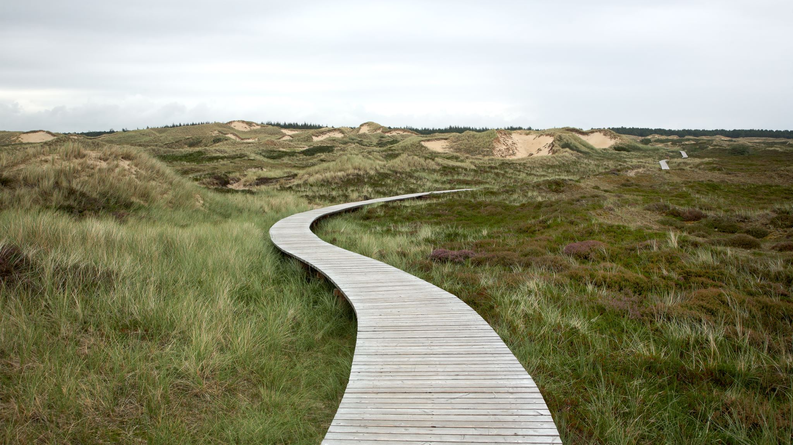
The Way – How Can I Be Sure I Am Going to Heaven? Ch. 7

Slide 2
Question 1 . . .
How would you put into words the only way Jesus said one can go to Father’s House?
(p. 116)

Slide 3
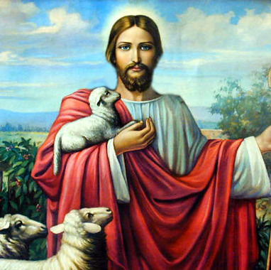
Question 2 . . .
There are 7 “I AM” statements about Jesus found in the Gospel of John.
How are these statements completed:
I am the __________ of life.
I am the __________ of the world.
I am the __________ to the sheepfold.
I am the good _________ .
I am the __________ and the life.
I am the ____, the ____ and the _______ .
I am the true _____ .
Which of these statements means the most to you at this time in your life?
This Photo by Unknown Author is licensed under CC BY

Slide 4
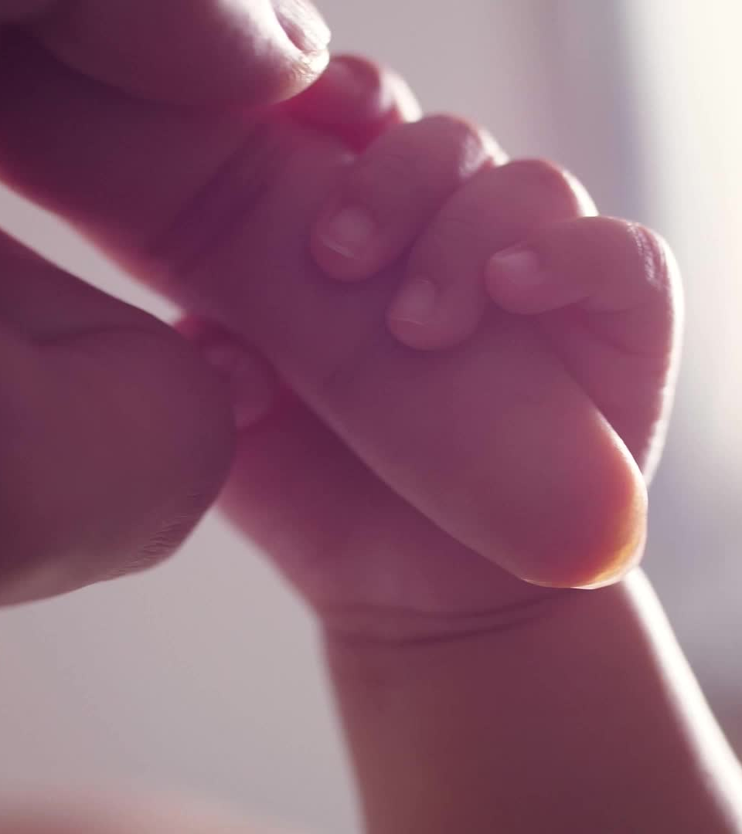
Child of God
3. Describe the difference between being created in the image of God and being a child of God. (p. 122)
What does John 1:12 tell us is required of a person to become a child of God?

Slide 5
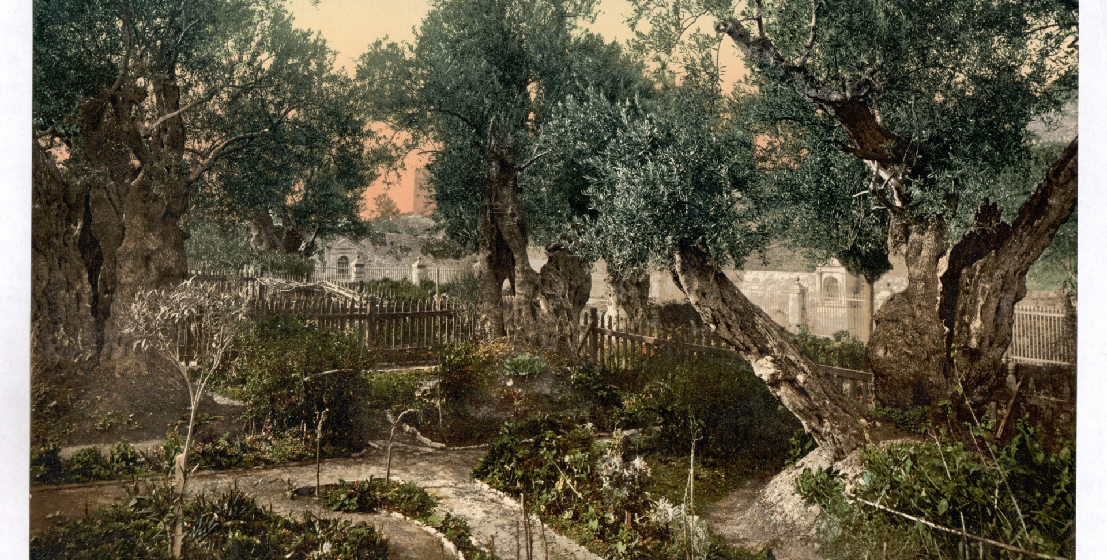
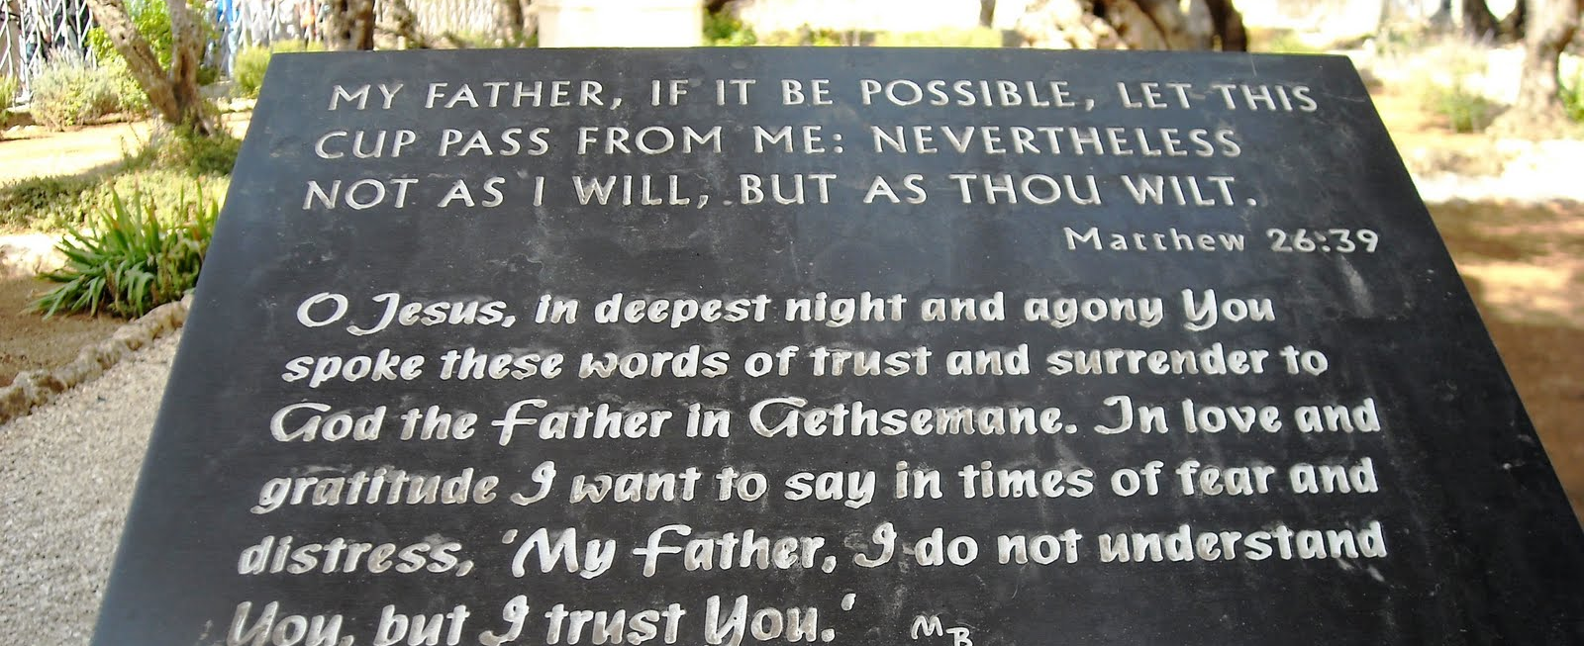
Garden of Gethsemane
4. When Jesus prayed in the Garden of Gethsemane for the Father’s will to be done, describe the physical toll it had upon Jesus.
(p. 127-128)
This Photo by Unknown Author is licensed under CC BY-SA-NC

