Slide 1
Absence—What Do I Do with My Doubt and Disappointment?
Ch. 8

Slide 2
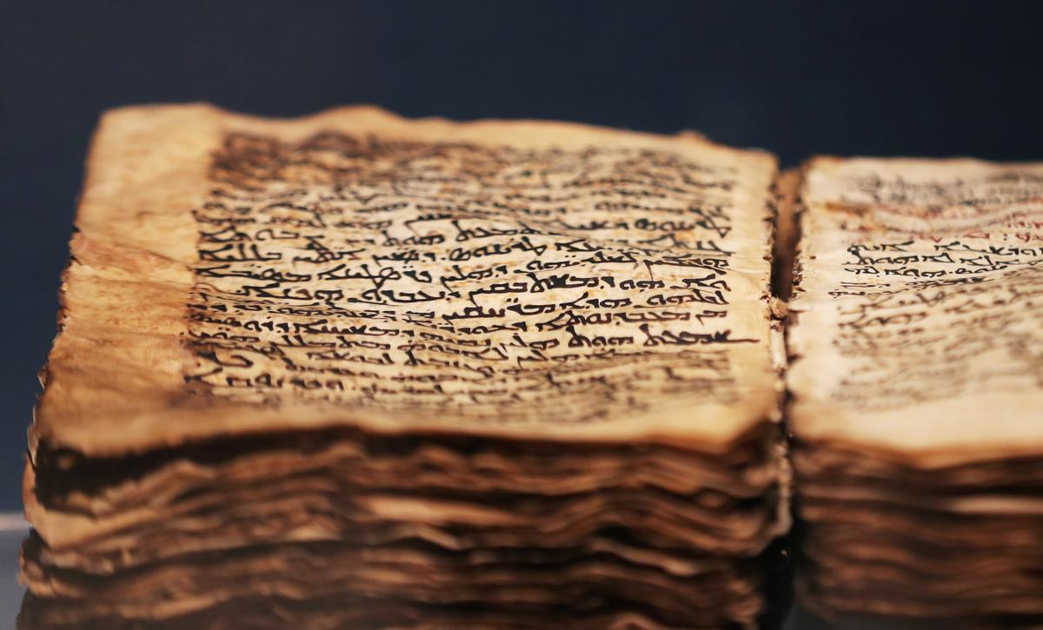
Scripture Matthew 26:57-58
1. Many prophecies given hundreds of years before were fulfilled during the trial of Jesus, His crucifixion and His resurrection. Let’s look at the following prophecies and discuss how they were fulfilled. (p. 139-146)
Psalm 41:9
Psalm 2:12
Zechariah 13:7
Psalm 22:7
Psalm 22:18
Psalm 34:20
Zechariah 12:10
Psalm 31:5
This Photo by Unknown Author is licensed under CC BY-SA

Slide 3
2. How does the fulfillment of prophecy affect you?

Slide 4
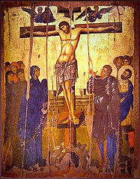
Crucifixion of Jesus
All the apostles except John were absent during the crucifixion of Jesus; however, chapter 8 identifies individuals who were near Jesus at that time.
Can you explain who is identified as a stranger…an enemy…a criminal…and two men afraid to admit they followed Jesus?
This Photo by Unknown Author is licensed under CC BY-SA

Slide 5
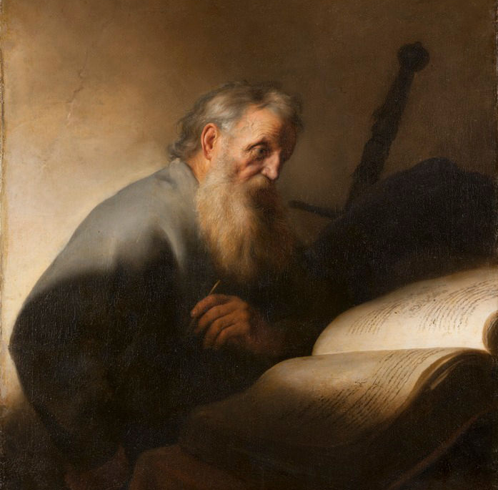
Thomas . . .
4. Chapter 8 speaks of Thomas’ doubt and disappointment that led to him isolating himself from the other apostles and missing Jesus appearing to them after the Resurrection.
In what ways does isolation from other Christians take a toll on our physical, mental, emotional, and spiritual health? (p. 155)
This Photo by Unknown Author is licensed under CC BY-SA

Slide 6
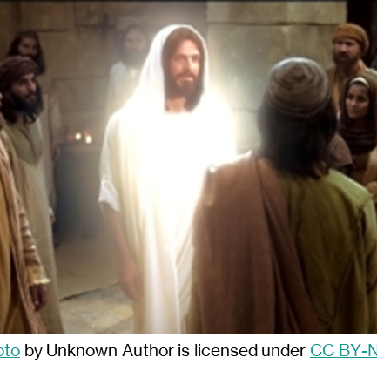
Love of Jesus . . .
Seeing this as God’s love inviting everyone to come closer to Him, what are some ways we can demonstrate this love from God to others? (p. 154)

Slide 7
Prayer

