Slide 1
Ch. 9 Presence
Will I Accept Jesus’ Invitation to Come Closer No Matter What Tries to Drive Me Away?

Slide 2
Scripture John 20: 24-29

Slide 3
Thomas was pursued by the other apostles when he missed the first meeting that Jesus had with the apostles after the resurrection.
If there was a time when you stopped attending church faithfully, tell us how someone reached out to you and helped you come back.
How did God work through you to help bring someone back into fellowship with the group?

Slide 4
Introspection
2. Have you had an experience where you doubted that God was answering a certain need in your life, and you told Him that you did not see how you could serve Him “unless” He did something about it?
Did your faith grow to the point of saying “regardless” of whether God answers the way I thought He should, I will serve Him with all my heart? (p. 171)

Slide 5
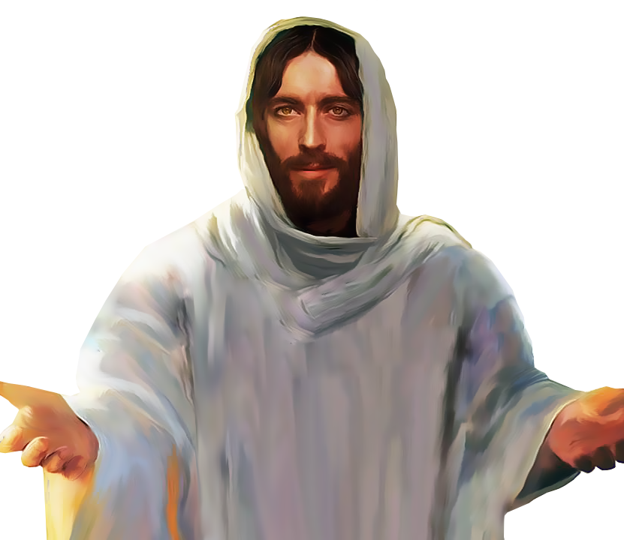
Resurrected Christ
3. When the resurrected Christ appeared to Thomas and the other disciples, what might Jesus have said to Thomas?
What did Jesus say to Thomas that answered his deepest need?
Also, what command did Jesus give Thomas? (p. 163)
This Photo by Unknown Author is licensed under CC BY-NC

Slide 6
Doubts in Our Lives . . .
4. The authors list seven doubts that a person may deal with, each one followed by Scriptures to answer the doubts. (pp 191-196)
After I read aloud the list of doubts, I will invite you to tell us if you have struggled with any of them and how you found your answers in God’s word.

Slide 7
Insights . . .
5. How has this study of the life of Thomas impacted you and drawn you closer to Jesus? (p. 172)

